Slide 1
Model Evaluation in Machine Learning

Slide 2
Why do I need this?
Prediction is an iterative task: after building your model, measure its performance and start again until you make progress. And progress is measured by «metrics». Therefore, metrics are the only way to understand if you are doing OK or not.
The choice of which metric to use depends on various factors, including the problem you are trying to solve; how you want to penalize errors and the model you are building.

Slide 3
Metrics for regression
Mean Absolute Error (MAE)
The MAE is a simple way to measure error magnitude. It consists on the average of the absolute differences between the predictions and the observed values. The measure goes from 0 to infinite, being 0 indicates the you are doing great!
Mathematically you will have values near to zero which means your model is doing fine.

Slide 4
Metrics for regression Cont.
Root mean squared error (RMSE)
The RMSE measures the quadratic mean of the differences between the predictions made by a model and the actual values (residuals). The measure is always positive or 0, being this last value the best one possible.
RMSE is the square root of the average of squared errors, the size of the error matters and large errors are penalised. Thus, this is a very sensitive metric to outliers.
Detecting outliers might help you to improve your model.

Slide 5
Metrics for regression Cont.
Relative Squared Error (RSE)
It measures performance based on a comparison with a simple predictor performance. The RSE normalizes the total squared error of the tested model and divides it by the total squared error of the simple predictor.
Just like the other two measures, it ranges from 0 to infinite, being 0 the best value.

Slide 6
Metrics for regression Cont.
Coefficient of Determination (R2 or R-squared)
The R2 is the proportion of the variance in the dependent variable that is predictable from the independent variable It explains how well a model performs when replicating the observed outcomes.
Usually, R-squared is measured on values between 0 and 1, but some other definitions of the R2 admit values from -∞ to 1. In general, values closer to 1 are better than values closer to 0 or negative ones.
This time values closer to 1 indicates better.

Slide 7
Metrics for classification
Confusion Matrix
A Confusion Matrix is a N x N matrix where N represents the classes you are trying to predict. It shows how many predictions where made correctly or incorrectly, but it also shows if they were false positives or false negatives.

Slide 8
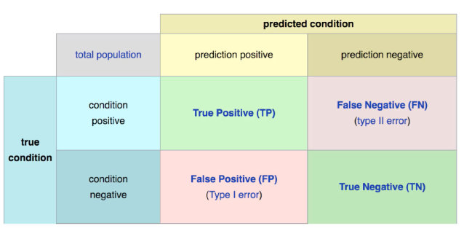
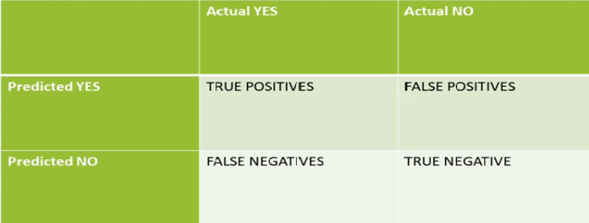
Metrics for classification -Confusion Matrix
When you have a binary classification problem at hand. This is your bread and butter to detect any anomalies in your model.
A true positive is an outcome where the model correctly predicts the positive class. Similarly, a true negative is an outcome where the model correctly predicts the negative class.
A false positive is an outcome where the model incorrectly predicts the positive class. And a false negative is an outcome where the model incorrectly predicts the negative class.

Slide 9
Metrics for classification -Confusion Matrix
Sometimes accuracy does not tell the whole story, a test for a rare disase can be 99% accurate by just guessing “no” all the time. A confusion matrix shows true negative, false negative, false positive.

Slide 10
Metrics for classification
From the Confusion Matrix, it’s possible to derive some metrics, such as:
Accuracy: represents the number of correct predictions divided by the total number of predictions.
Precision: it’s the division of the positive cases correctly identified by all the cases identified as positive (including false-positives).
True positives/(true positives + false positives
Correct positives
percent of relevant results, good choice when u care about false positives
medical screening, drug testing(u dont wanna say someone, you are addicted when theyare not)
Negative predictive value: it’s the same as precision, but for negative cases: it’s the number of true-negatives divided by the total of negatives identified by the model (including false-negatives).

Slide 11
Metrics for classification Cont.
Recall (or sensitivity): it’s the division of the true-positives by all the real positive cases (including false-negative cases). It matters when you are trying to have more true-positives than true-negatives. True positives/ (true positives + false negatives)
AKA sensitivity, true positive rate, completeness. Percent of positives correctly predicted.
Good choice of metric when you care alot about false negatives.
Good usage when u have fraud detection.
F1 Score: it’s the combination of the sensitivity and the recall. It’s represented by (2 * Precision * Recall) / (Precision + Recall) . harmonic mean of precision and sensitivity. When you care about precision And recall
Specificity: the same as recall, but for negative examples: it’s the division of the true-negatives by all the real negative cases (including false-positives). It matters when you are trying to have more true-negatives than true-positives. TN/TN+FP : true negative rate
Cohen’s Kappa: it’s a calculation that compares the real accuracy with the random accuracy. This is specially useful for problems with unbalanced classes. It’s calculated by (Observed accuracy — Expected accuracy) / (1 — Expected accuracy).

Slide 12
Metrics for classification Cont.
AUC-ROC and Gini Coefficient
To find the AUC-ROC, we plot the Sensitivity and the Specificity (1-specificity). Then, we calculate the area under the curve (AUC) and the ratio between the AUC and the total possible area. We obtain a number between 0 and 1, where 1 is our best possible value (attention to overfitting here).
The Gini coefficient is derived from the AUC-ROC. In this way:
Gini = 2*AUC — 1
To be considered a good model, we must have a Gini above 60%.

Slide 13
Metrics for classification Cont.
Logarithmic loss
To use log loss, your model has to be able to output a probability between 0 and 1. This metric will then compare the distance between the probability outputted by the model with the actual label. So, the log loss takes into account the uncertainty of a prediction based on how much it varies from the actual label.
A good log loss value is the one that is closer to 0, being the best possible model the one with log loss of 0. The log loss value increases when the prediction is different from the actual observation. So, a prediction of 0.42 for a label 1 is better than a prediction of 0.12 for the same label.
Values closer to 0 are better than higher values.

Slide 14
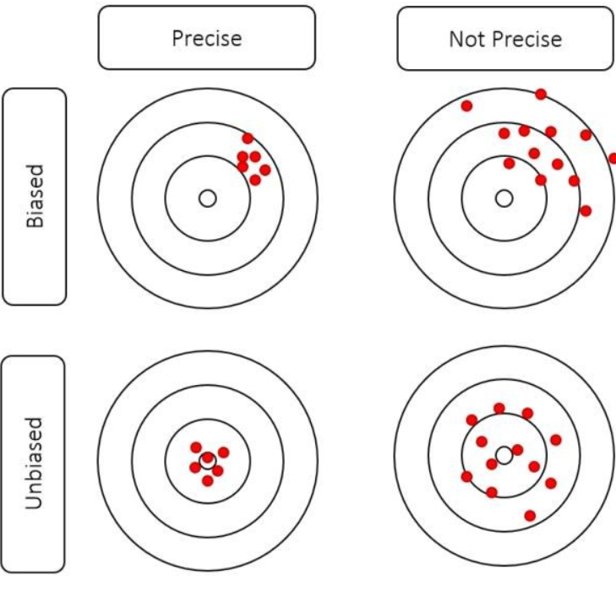
Bias & VarianceTrade-off in your Models
Bias is the difference between the average prediction of our model and the correct value which we are trying to predict. Model with high bias pays very little attention to the training data and oversimplifies the model. It always leads to high error on training and test data.
Variance is the variability of model prediction for a given data point or a value which tells us spread of our data. Model with high variance pays a lot of attention to training data and does not generalize on the data which it hasn’t seen before. As a result, such models perform very well on training data but has high error rates on test data.

Slide 15
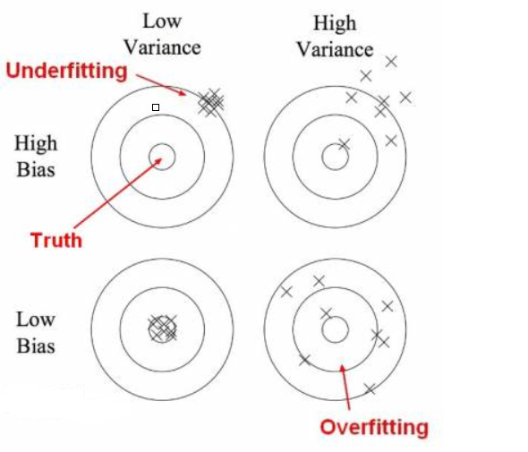
Bias & VarianceTrade-off - Cont
In this diagram, center of the target is a model that perfectly predicts correct values. As we move away from the bulls-eye our predictions become get worse and worse. We can repeat our process of model building to get separate hits on the target.

Slide 16
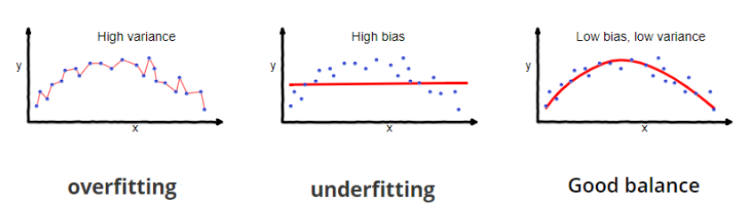
In supervised learning, underfitting happens when a model unable to capture the underlying pattern of the data. These models usually have high bias and low variance. It happens when we have very less amount of data to build an accurate model or when we try to build a linear model with a nonlinear data. Also, these kind of models are very simple to capture the complex patterns in data like Linear and logistic regression.
In supervised learning, overfitting happens when our model captures the noise along with the underlying pattern in data. It happens when we train our model a lot over noisy dataset. These models have low bias and high variance. These models are very complex like Decision trees which are prone to overfitting.

Slide 17
Why is Bias Variance Tradeoff?
If your model is too simple and has very few parameters then it may have high bias and low variance. On the other hand if our model has large number of parameters then it’s going to have high variance and low bias. So we need to find the right/good balance without overfitting and underfitting the data.
This tradeoff in complexity is why there is a tradeoff between bias and variance. An algorithm can’t be more complex and less complex at the same time.
To build a good model, we need to find a good balance between bias and variance such that it minimizes the total error.

Slide 18
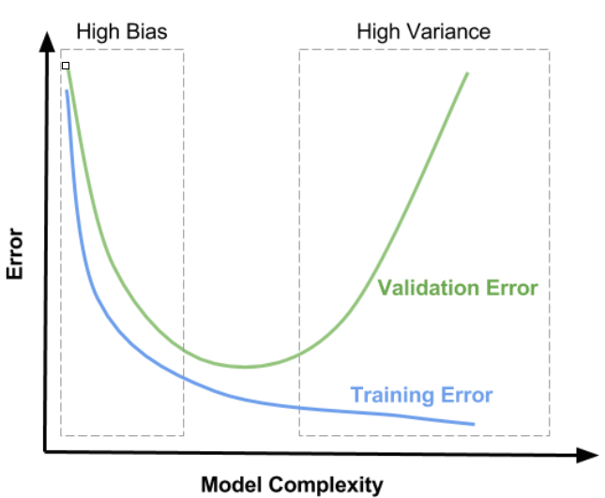
Bias & VarianceTrade-off - Cont
Here is some tips for you to deal with bias& variance problems:
1-Getting more training examples : good when you have high variance.
2-Trying smaller set of features: good when you have high variance.
3-Try adding polynomial features: good when you have high bias.
4- Getting more data when you have high bias most likely will not help you.
5- If your learning algorithm is suffering from high variance, then getting more data might help.
High bias : Underfit
High variance: Overfit

Slide 19
AB Testing Intuition
When it comes to your typical product or engineering org, team members are often left wondering ifthe thing they did had an impact, or whether the option they went with among many different design options was actually the best. As these organizations want to move towards data-informed design decision, AB testing is first in line.
AB testing is a methodology of comparing multiple versions of a feature, a page, a button, etc. by showing the different versions to customers or prospective customers and assessing the quality of interaction by some metric (Click through, purchase, following any call to action, etc.). Any time you want to test multiple variations of something is a great use case for AB testing.

